Slide 1
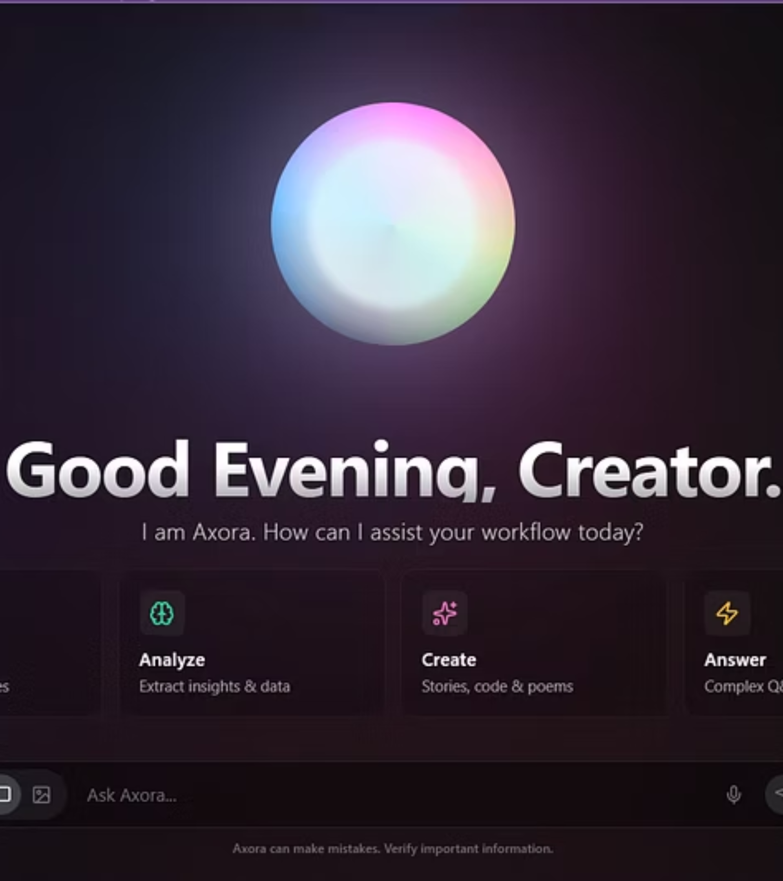
Axora.ai -Autonomous AI System
By Syed Anas & M.Abdullah
An intelligent autonomous AI engine powered by LLMs, image models, and dynamic workflows.

Slide 2

Project Overview: Unleashing Autonomous AI
Autonomous Agent
Multi-Modal Capabilities
Axora.ai acts as a fully autonomous AI agent, designed to comprehend user intent and execute a wide array of AI-driven tasks seamlessly.
The system intelligently performs various AI tasks, from understanding complex queries to generating high-definition images, and structuring responses.
Full-Stack Production Grade
Running on a robust cloud backend and a modern React frontend, Axora.ai is a production-ready solution built for scalability and performance.

Slide 3



Core Technologies: The Axora.ai Foundation
React + Vite Frontend
Node.js + Express Backend
Hugging Face Inference API
Developed for a fast, responsive, and intuitive user experience with modern web standards.
A powerful and efficient server-side architecture handling API requests and data processing.
Leveraging state-of-the-art AI models for both text intelligence and image generation.

Slide 4

System Architecture: The Brains Behind Axora.ai
Router Inference
Frontend (React + Tailwind)
Hugging Face routing for model calls
Vercel hosting, Mode selector
Hugging Face Cloud
Axora.ai System Architecture
Live Thinking UI
SmolLM3-3B and SDXL models
Realtime responses, progress view
Backend (Node.js + Express)
API Endpoints
/api/hf and /api/hf-image
Render hosting, request router
The diagram above illustrates the seamless flow of data and logic that powers Axora.ai's autonomous capabilities, from user interaction to AI inference.

Slide 5


The Models Used: Powering Axora.ai Capabilities
Axora.ai leverages cutting-edge AI models to deliver its autonomous text and image generation features. These models are carefully selected for their performance, efficiency, and ability to handle complex tasks.
SmolLM3-3B (Text LLM)
Stable Diffusion XL (Image Model)
A lightweight, yet powerful 3 billion parameter model, optimized for rapid text processing.
Our choice for state-of-the-art image generation, offering unparalleled visual fidelity.
Supports robust chat completion API.
Delivers high-resolution, photorealistic or artistic images.
Excels in text generation, summarization, and Q&A.
Features fast inference speeds for dynamic content creation.
Capable of advanced analysis, writing, and creative tasks.
Primarily used for sophisticated text-to-image generation.
Known for its speed, cost-efficiency, and production-readiness.
Ideal for creating intricate 3D scenes and compelling concept art.
These foundational models work in synergy to enable Axora.ai to understand complex requests and produce highly relevant, multi-modal outputs.

Slide 6

Data Flow Pipeline: From Prompt to Perception
Backend ↔ Hugging Face
Frontend → Backend
User → Frontend
This pipeline illustrates the journey of a user's request through Axora.ai's architecture, culminating in a dynamic, AI-generated response.

Slide 7





Key Features: Intelligence at Your Fingertips
Text Mode
Smart task detection
Summaries & deep analysis
Long answers & creative writing
Multi-action workflows
Robust error handling
Image Mode
Stunning AI image generation
Direct image download
Clean UI presentation
High-definition output
Diverse creative styles

Slide 8





Use Cases: Expanding Possibilities with Axora.ai
Axora.ai is designed to empower a diverse range of users, offering tailored solutions that enhance productivity and creativity across various domains.
For Students
For Creators
Notes summarization
Image generation
Assignment help
Story writing
Research assistance
Design concepts
For Developers
For Companies
Lightweight autonomous agent demo
Can be extended into:
Hugging Face API integration reference
AI support assistant
Document analyst

Slide 9


Cloud Deployment: Seamless Integration
Frontend Deployment (Vercel)
Backend Deployment (Render)
React + Vite for optimal performance
Node.js + Express server for robust operations
Utilizes VITE_BACKEND_URL for API calls
Automatic deployment directly from GitHub
Automatic builds and CDN delivery for global reach
Exposes dedicated API endpoints:
Fast, reliable, and scalable hosting
/api/hf for text ,/api/hf-image for image generation

Slide 10









Future Enhancements: The Road Ahead
Axora.ai is continuously evolving, with exciting features planned to further enhance its capabilities and user experience.
Voice Mode
File Upload (RAG)
Integrate voice interaction for natural language commands and responses.
Enable file uploads for Retrieval-Augmented Generation, providing context-aware answers.
LangGraph Agents
Vector DB Memory
Implement advanced agents using LangGraph for complex, multi-step tasks.
Develop a robust vector database memory system for persistent context and learning.
Resources
Explore the project's codebase and see the live demonstration.
GitHub : https://github.com/SyedAnas-123/AI_Autonomous_System
Project Demo : https://ai-autonomous-system.vercel.app

